Slide 1



Il cancro dello stomaco perforato/sanguinante
CHIRURGIA ONCOLOGICA PER IL CHIRURGO D’URGENZA
Prof. Giovanni de Manzoni
Chirurgia generale e dell’esofago e dello stomaco
Università di Verona

Slide 2

PERFORATED GASTRIC CANCER
BLEEDING GASTRIC CANCER
SEPTIC PATIENT
HEMORRHAGIC PATIENT

Slide 3

PERFORATED GASTRIC CANCER
It is a rare condition, accounting for 0.3-3% of gastric cancer cases
…BUT…gastric cancer is present in 10-16% of patients presenting with gastric perforation
Emergency condition of peritonitis
Oncologic technical aspects of surgery
Emergency presentation of the gastric cancer; prognosis and implications for service planning. World J Emerg Surg. 2012
Two-stage radical gastrectomy for perforated gastric cancer. EJSO 2000

Slide 4
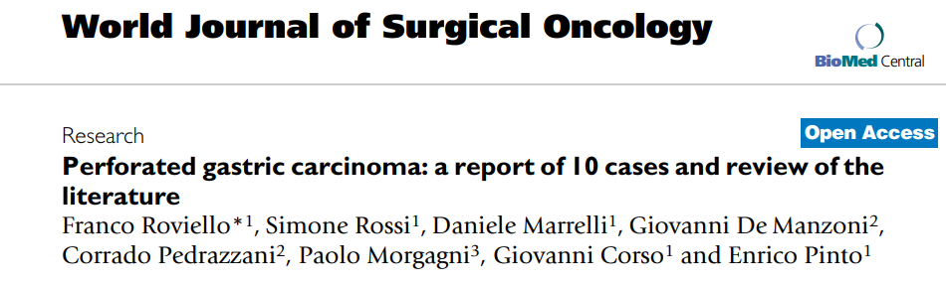

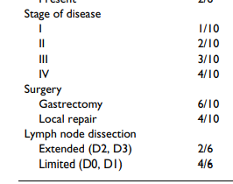
PERFORATED GASTRIC CANCER
World Journal of Surgical Oncology, 2006
Retrospective analysis of 2564 consecutive cases of gastric cancer operated in 3 Centers belonging to the Italian Research Group for Gastric Cancer
10 cases of perforation → incidence rate was 0.39%
(mortality 17%)
(mortality 75%)

Slide 5
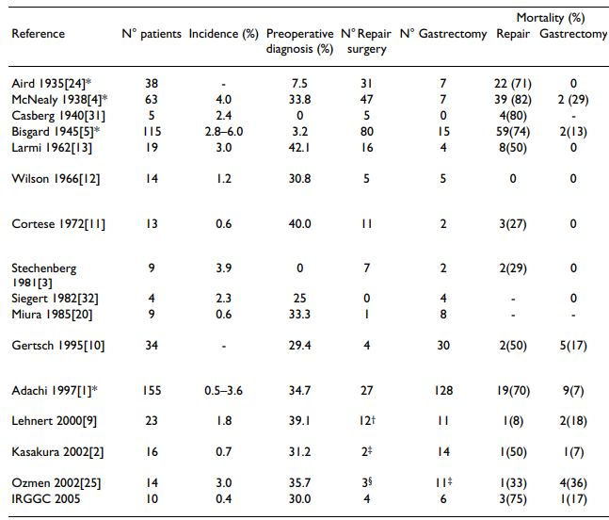
World Journal of Surgical Oncology, 2006
From the first study in 1935 until the early 1980’s:
the most frequent type of operation performed was the simple closure or the omental patch, sometimes associated with gastroenteroanastomosis.
High surgery-related mortality of this type of surgery (also due to the different kind of patients who undergo this type of minimal surgery: frail patients or in advanced unresectable tumors)
Over the years the resection rate has been increasing and the overall mortality rate has been decreasing.

Slide 6
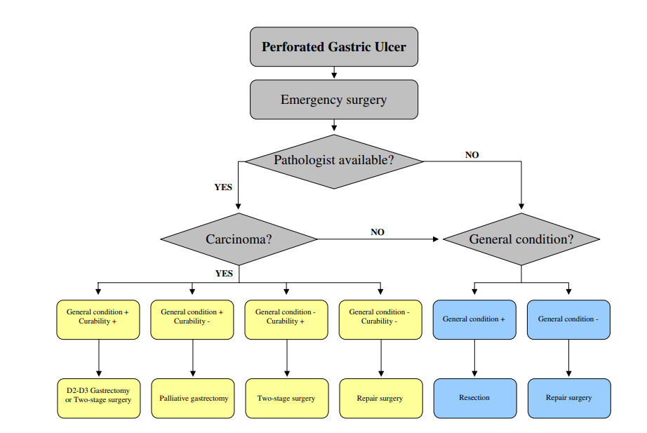
PERFORATED GASTRIC CANCER
World Journal of Surgical Oncology, 2006
The most important factors to be recalled in the management of a patient with histological diagnosis of perforated gastric carcinoma are:
the presence of preoperative shock
the gravity of peritonitis;
the curability of the neoplasm;
eventual comorbidities of the patient.

Slide 7

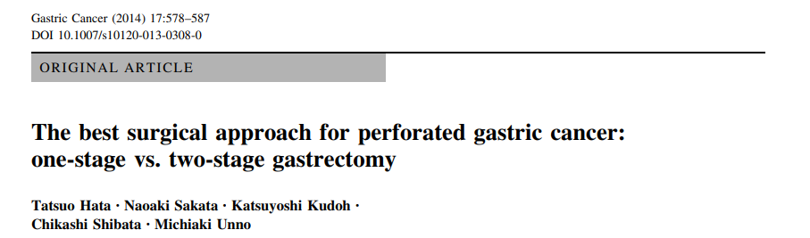
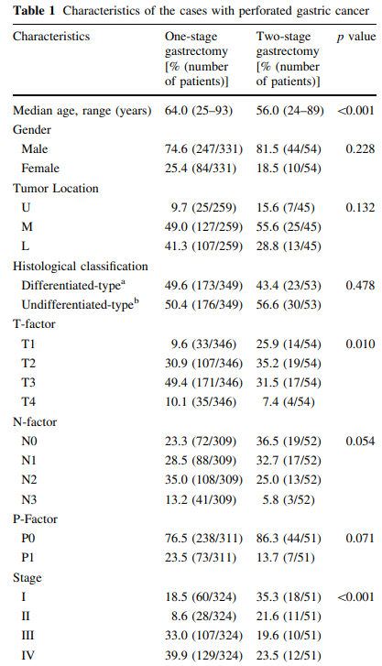
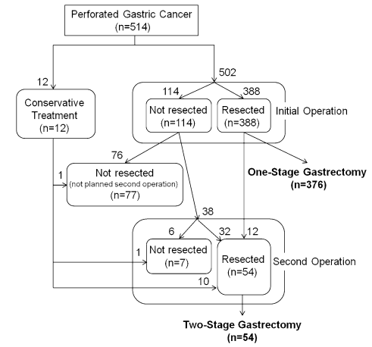
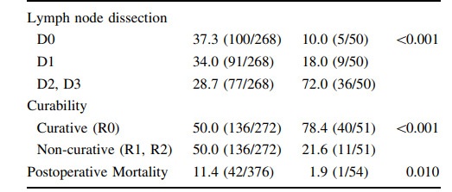
One-stage gastrectomy
Two-stage gastrectomy
More advanced tumour in one-stage gastrectomy
Better quality of lymphadenectomy, curability and LOWER mortality in two-stage group

Slide 8
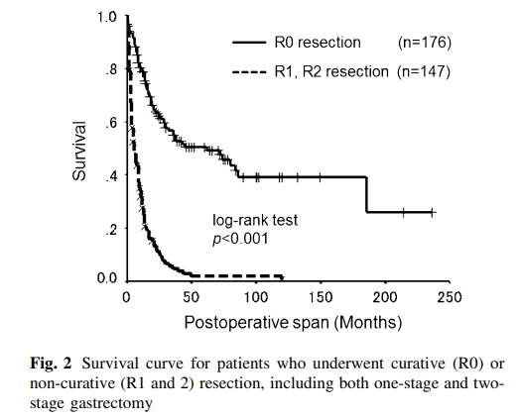
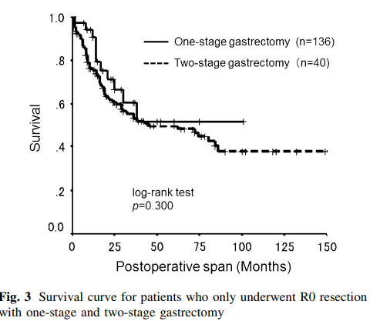

What about survival?
Most important goal for perforated gastric cancer is to achieve curative R0 resection, regardless of whether the surgical approach is a one-stage or two-stage gastrectomy.
Survival curve for patients who underwent curative (R0) or non-curative (R1 and 2) resection, including both one-stage and two-stage gastrectomy

Slide 9

Most important goal for perforated gastric cancer is to achieve curative R0 resection, regardless of whether the surgical approach is a one-stage or two-stage gastrectomy.
ONE-STAGE GASTRECTOMY
TWO-STAGE GASTRECTOMY
when gastric cancer can be diagnosed before or at surgery
in cases with limited peritonitis that can be expected to achieve curative R0 resection.
If curative R0 resection cannot be expected due to diffuse peritonitis, it is important to avoid non-curative and palliative gastrectomy and plan treatment only for the peritonitis at the initial surgery
Some patient characteristics were not equally distributed between the one-stage and two-stage gastrectomy groups. The one-stage gastrectomy group included older patients, with more invasive tumor depth, and more advanced staging than the two-stage group

Slide 10
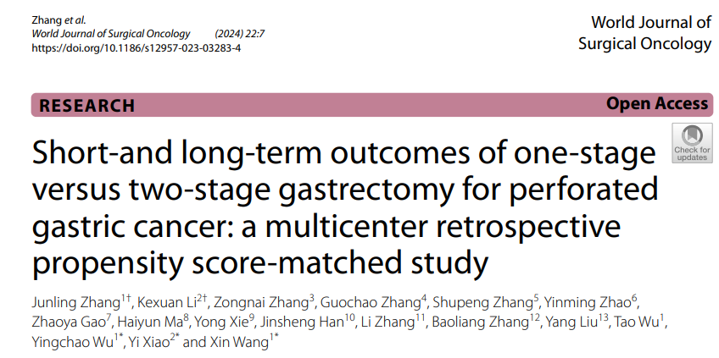
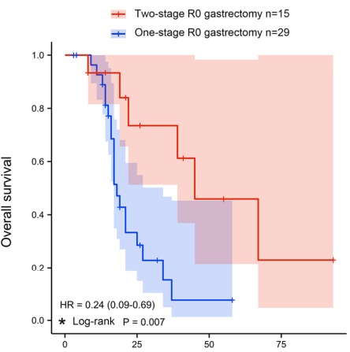
81 PGC patients from 13 medical institutions were retrospectively enrolled in this study.
The PGC patients who underwent R0 gastrectomy were divided into one-stage surgery and two-stage surgery groups.
415 regular gastric cancer patients without perforation were randomly selected as a control.
Patients in the two-stage group (median OS time is 45 months) had significantly better overall survival than those in the one-stage group (median OS time is 11 months, P=0.007)

Slide 11
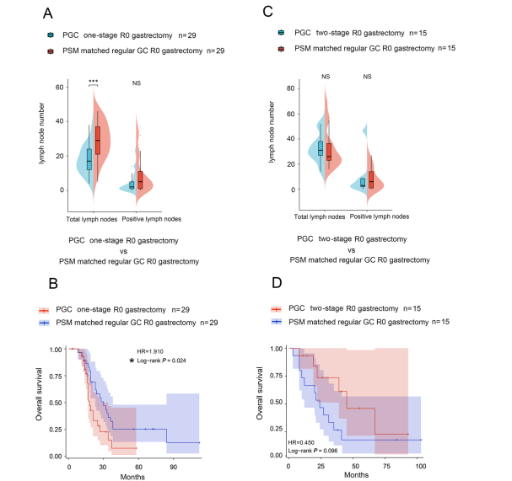
Compared with propensity score-matched regular GC patients without perforation, PGC patients who underwent one-stage gastrectomy had a poorer quality of lymphadenectomy [17 (12, 24) vs 29 (21, 37), and suffered a worse OS (Median OS: 18 months vs 30 months, P=0.024
For PGC patients in poor condition, two-stage treatment is a better option when D2 radical gastrectomy cannot be achieved in emergency surgery, based on findings that two-stage gastrectomy could provide PGC patients with a better quality of lymphadenectomy and a better OS.
Conversely, two-stage gastrectomy can achieve a comparable quality of lymphadenectomy (P=0.506) and a similar OS (P=0.096) compared to propensity score-matched regular GC patients.

Slide 12
PERFORATED GASTRIC CANCER
Patient’s hemodynamic stabilization
(fluid, antibiotics, eventually amine support…)
Evaluate patients’ general conditions, grade of peritoneal contamination, if a pre- or intra-operative suspected diagnosis of malignancy is available
Whenever it’s possible
If M+, prefer ‘stomach preserving’ strategy if possible
TWO-STAGE GASTRECTOMY
Damage control
+
Gastrectomy + adequate lymphadenectomy

Slide 13
PERFORATED GASTRIC CANCER
BLEEDING GASTRIC CANCER
SEPTIC PATIENT
HEMORRHAGIC PATIENT

Slide 14




BLEEDING GASTRIC CANCER
Prevalence of bleeding in gastric cancer patients is estimated to be 1–8%, necessitating prompt and effective hemostatic intervention
ENDOSCOPIC
EMBOLIZATION
SURGERY
RADIOTHERAPY
Severe upper gastrointestinal tumor bleeding: endoscopic findings, treatment, and outcome. End,1996. Endoscopic evaluation of 125 cases of upper gastrointestinal bleeding. Ann Surg,1981.
Management of bleeding from unresectable gastric cancer. Biomedicines, 2019

Slide 15

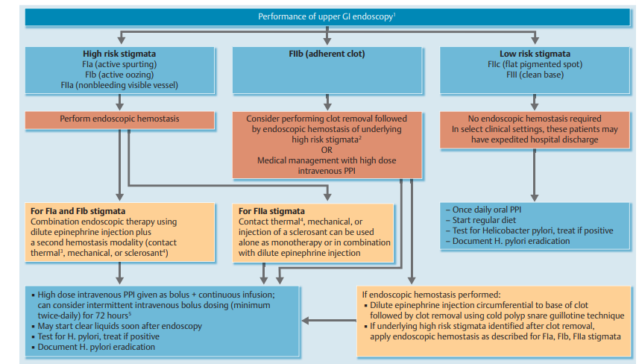
BLEEDING GASTRIC CANCER
Following hemodynamic resuscitation, it is recommended
EARLY (≤24 hours) upper GI endoscopy.
VERY EARLY (< 12 hours) upper GI endoscopy may be considered in patients with high risk clinical features (hemodynamic instability that persists despite ongoing attempts at volume resuscitation; in-hospital bloody emesis/nasogastric aspirate; or contraindication to the interruption of anticoagulation)

Slide 16
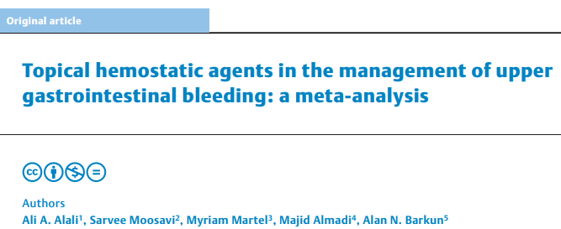
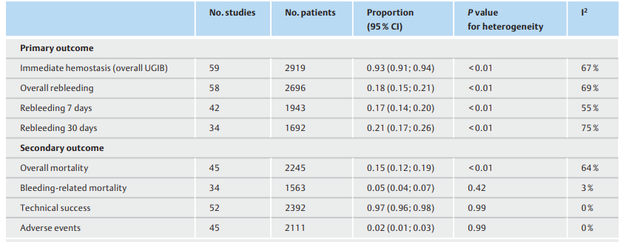
A total of 59 studies with a total of 3,417 patients were included in the analysis.
Immediate hemostasis was achieved in 93 % (91 %; 94 %), with similar results according to etiology (NVUGIB vs. variceal), topical agent used, or treatment strategy (primary vs. rescue).
The overall rebleeding rate was 18 % (15%; 21 %) with the majority of rebleeds occurring in the first 7 days.

Slide 17
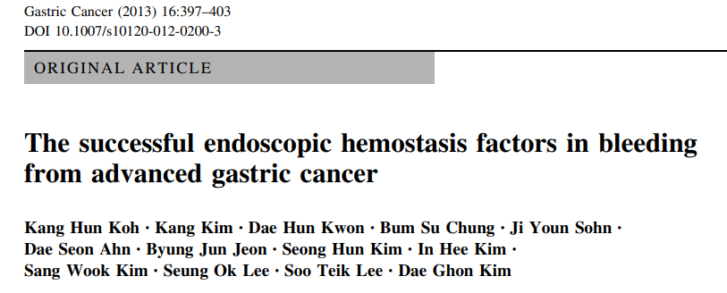
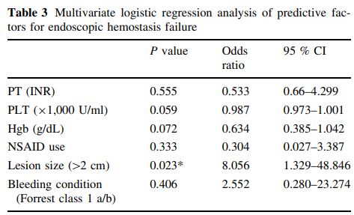
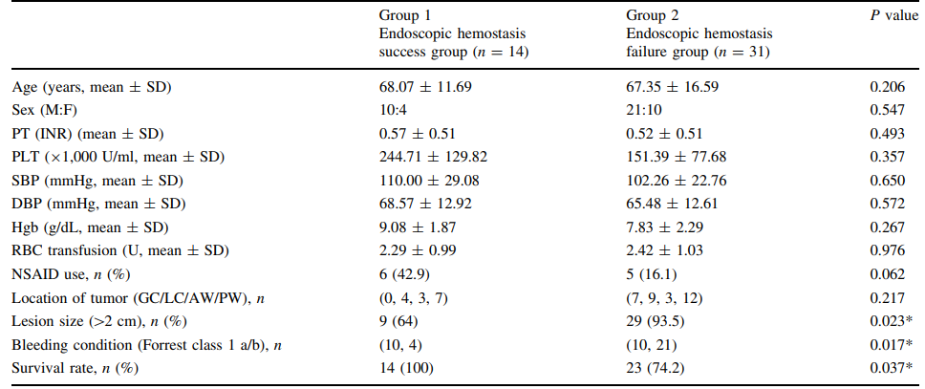
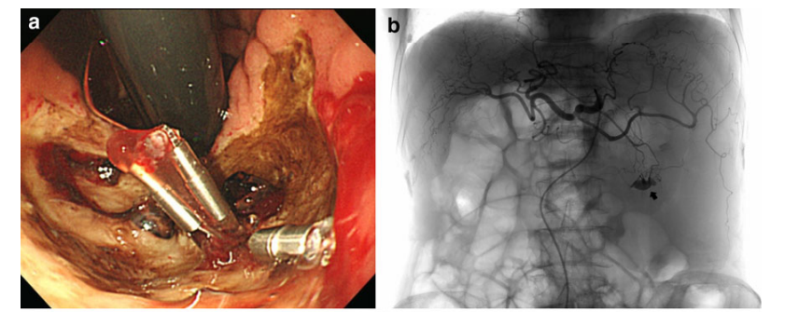
45 pts divided into:
14 patients who had experienced successful endoscopic hemostasis
31 patients who had had unsuccessful hemostasis with the first endoscopy and then underwent embolization (TAE)
Lesion size and bleeding condition of Forrest class 1a or 1b were statistically significant predictive factors for endoscopic hemostatic failure (P = 0.023 and P = 0.017, respectively).

Slide 18
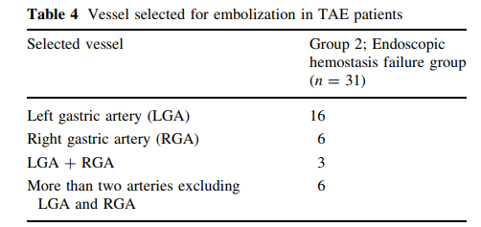
Small bleeding lesions (<2 cm) and exposed vessels in the bleeding site with gastric cancer indicated that endoscopic hemostasis would be an effective hemostatic modality to choose.
While,the presence of large bleeding lesions (>2 cm) and non-exposed vessel bleeding, endoscopic hemostasis failure is predicted, and TAE could be recommended.

Slide 19
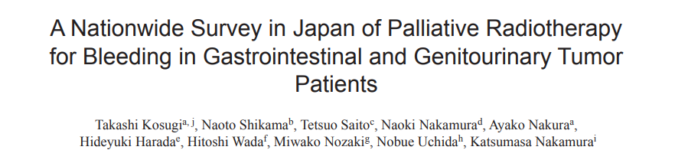

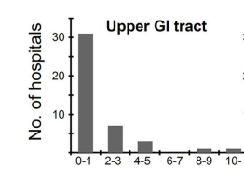
What about Radiotherapy??
54 radiation oncologists at 43 facilities answered.
Most of the them reported that they conducted hemostatic irradiation for less than one patient per year, though the median annual number of patients treated with radiotherapy in these facilities was 594.
World J Oncol. 2016
A survey was conducted by the palliative radiotherapy working group of the Japanese Radiation Oncology Study Group (JROSG), focusing on annual cases of radiotherapy for tumors of the upper and lower gastrointestinal tracts and applicable fractionated doses for three hypothetical patients.
.

Slide 20
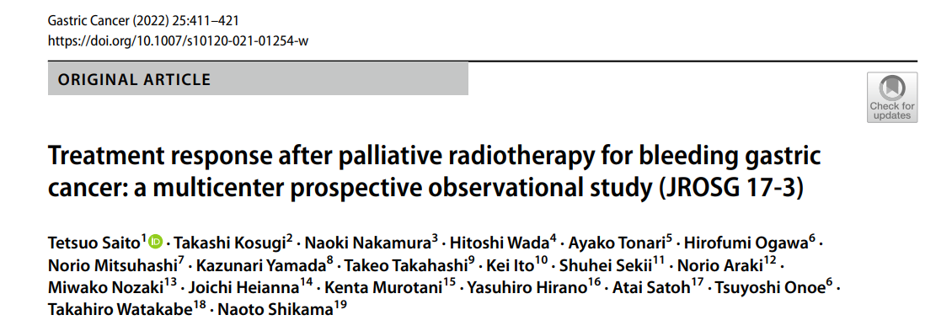
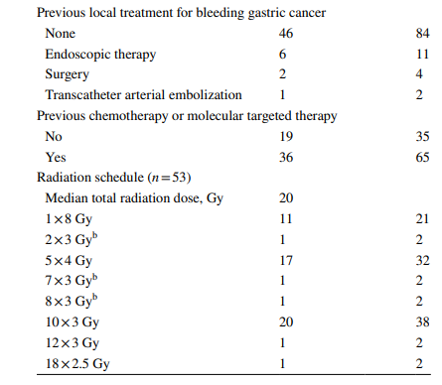
What about Radiotherapy??
55 patients from 15 institutions. The ITT response rates were 47%, 53%, and 49% at 2, 4, and 8 weeks, respectively. The per-protocol response rates were 56%, 78%, and 90% at 2, 4, and 8 weeks, respectively. Neither response nor BED (α/β=10) predicted overall survival. Multivariable Fine-Gray model showed that BED was not a significant predictor of response. Univariable Cox model showed that BED was not significantly associated with re-bleeding. Grades 1, 2, 3, and,≥4 radiation-related adverse events were reported in 11, 9, 1, and 0 patients, respectively.

Slide 21
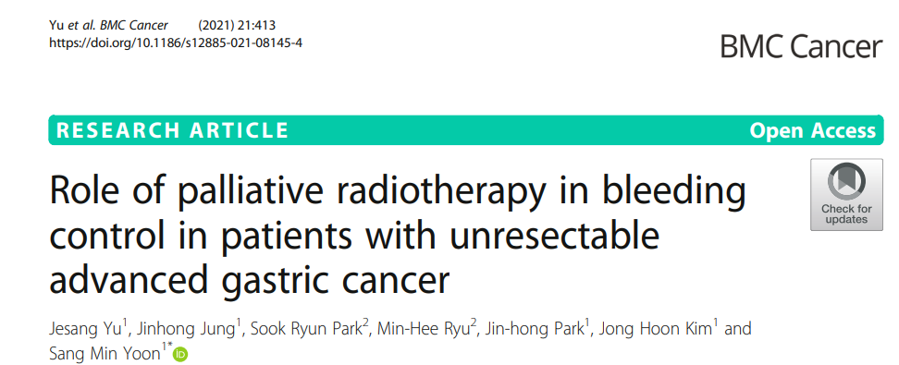
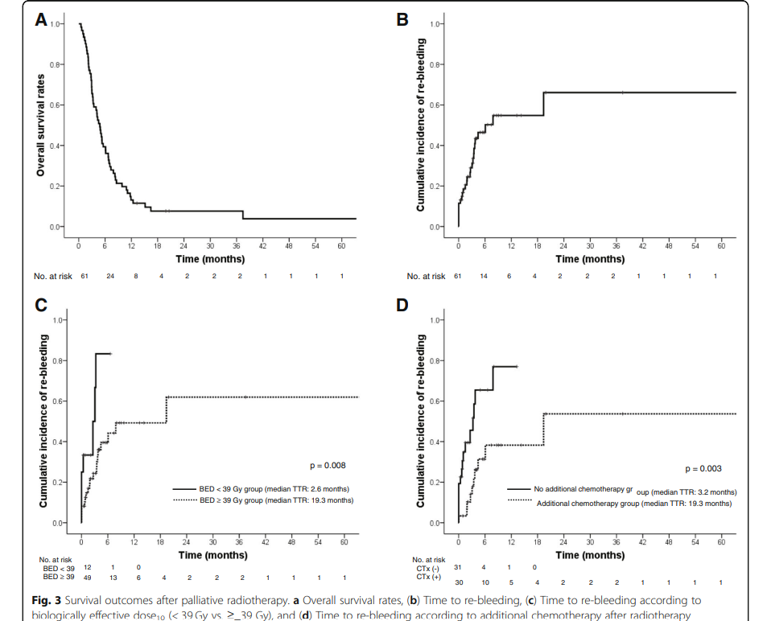
What about Radiotherapy??
OS
Time to rebleed
61 pts treated with RT palliative for bleeding tumour.
Bleeding control was achieved in 54 (88.5%) patients
Among the 54 patients who achieved bleeding control, 19 (35.2%) experienced re-bleeding during the follow-up period.
The median time to re-bleeding was 6.0 months.

Slide 22
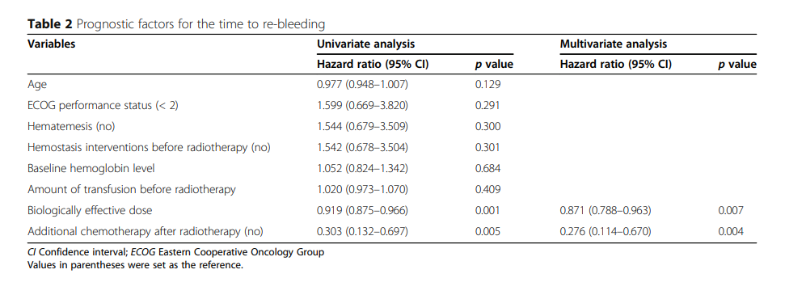
What about Radiotherapy??
Multivariate analysis demonstrated that a higher radiation dose (p = 0.007) and additional chemotherapy after radiotherapy (p = 0.004) were significant factors for prolonging the time to re-bleeding

Slide 23
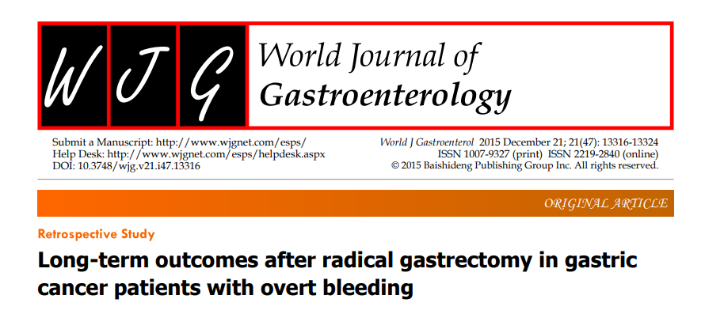
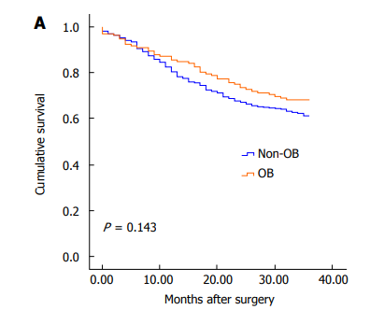
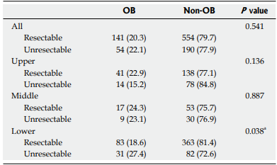
…should we talk about surgery?
695 (74.0%) were hospitalized for potential radical gastrectomy. Of these:
132 bleeding pts: 128 achieved hemostasis + elective surgery and 4 failed hemostasis→ emergency surgery
521 pts without bleeding
NO significant difference in the percentage of OB patients between resectable cases and unresectable cases (20.3% vs 22.1%, P = 0.541).
NO significant difference in 3-year OS rate (68.2% vs 61.2%, P = 0.143) or clinicopathological characteristics (P > 0.05) between these patients with and without OB

Slide 24
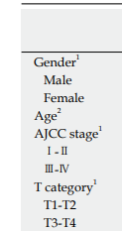
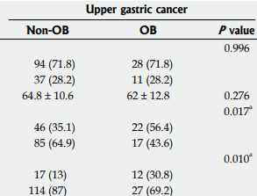
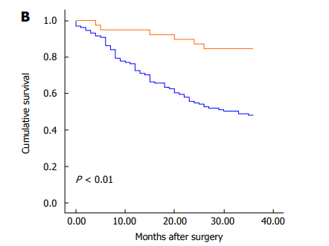

Subgroup analysis based on tumor location showed that the 3-year OS rate of upper gastric cancer was significantly higher in patients with OB (84.6%) than in those without OB (48.1%, P < 0.01) and
AJCC stages Ⅰ-Ⅱ (56.4% vs 35.1%, P = 0.017) and T1-T2 category tumors (30.8% vs 13%, P = 0.010) were more frequent in patients with OB than in those without OB

Slide 25
…when should we think about surgery?
In case of resectable GC, after control of bleeding
Multidisciplinary discussion
Upfront surgery with adequate lymphadenectomy and curative intent or neoadjuvant chemotherapy, based on tumor stage

Slide 26
BLEEDING GASTRIC CANCER
Patient’s hemodynamic stabilization
(fluid, trasfusion, eventually amine support…)
Think about emergency (palliative) surgery only in rare cases of unsuccessful hemostasis
Endoscopic evaluation: assess the risk and treat the bleeding
In case of failure of endoscopic therapy or rebleeding → Embolization
Palliative short-course radiotherapy in case of unresectable/metastatic GC
Hemodynamic stability and treatment of bleeding:
neoadjuvant chemotherapy or upfront surgery according to tumour stage

Slide 27


GRAZIE PER L’ATTENZIONE

